Slide 1

DECISION TREE LEARNING AND REPRESENTATION
Mano Prashanth R[192412601]
ITA0603[Machine Learning]

Slide 2
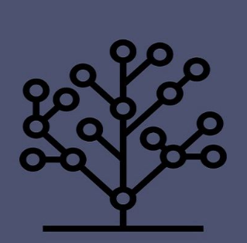
INTRODUCTION
A Decision Tree is a supervised machine learning algorithm.
It is used for classification and regression tasks.
It makes decisions by splitting data into branches based on feature values.
The final prediction is made at the leaf node.
Decision Trees are easy to understand and visualize, making them suitable for both beginners and experts.
They require minimal data preprocessing and can handle both numerical and categorical data.

Slide 3
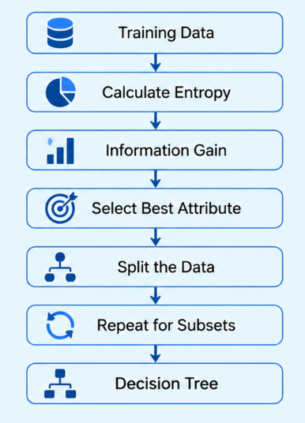
Working of Decision Tree
Start with the complete training dataset.
Calculate the Entropy of each attribute to measure data impurity.
Compute the Information Gain for every attribute.
Select the attribute with the highest Information Gain as the decision node.
Split the dataset into smaller subsets based on the selected attribute.
Repeat the process for each subset until a stopping condition is reached.
Create Leaf Nodes to assign the final class label or prediction

Slide 4

ENTROPY AND INFORMATION GAIN
Entropy
Measures the impurity or randomness of data.
Lower entropy means better classification.
Formula
Information Gain
Measures the reduction in entropy after splitting the data.
Higher Information Gain indicates a better attribute for splitting.

Slide 5
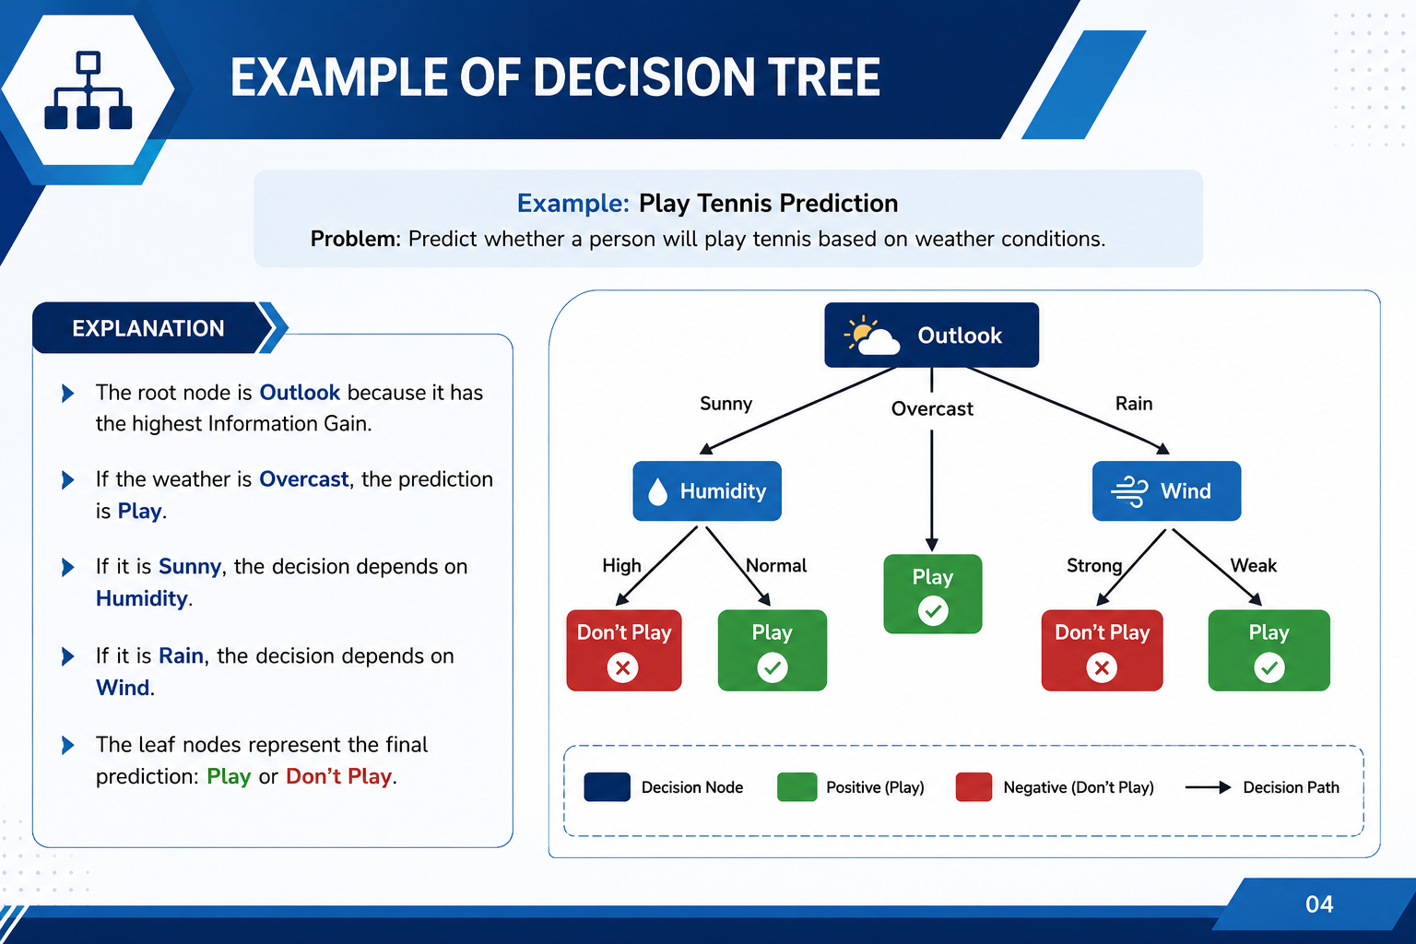
Example of Decision Tree

Slide 6
TREE PRUNING, ADVANTAGES & LIMITATIONS
Tree Pruning
Advantages
Removes unnecessary branches.
Reduces overfitting.
Improves prediction accuracy.
Easy to understand and visualize.
Requires minimal data preprocessing.
Fast prediction.
Limitations
Can overfit the training data.
Sensitive to noisy data.
May become complex for large datasets.

Slide 7
APPLICATIONS
Decision Trees are used in healthcare to predict diseases and assist doctors in making accurate diagnoses.
Banks use Decision Trees to evaluate loan applications and assess the creditworthiness of customers.
E-commerce companies apply Decision Trees to recommend products based on customer preferences and purchasing behavior.
Cybersecurity systems use Decision Trees to detect fraudulent transactions and identify suspicious activities.

Slide 8
CONCLUSION
Decision Trees are powerful supervised machine learning algorithms.
They classify data using Entropy and Information Gain.
Tree Pruning helps prevent overfitting and improves model performance.
They are simple, interpretable, and widely used in real-world decision-making.
They provide fast predictions and require minimal data preprocessing.
Decision Trees form the foundation for advanced ensemble methods such as Random Forest and Gradient Boosting.

Slide 9
THANK
YOU

